Slide 1


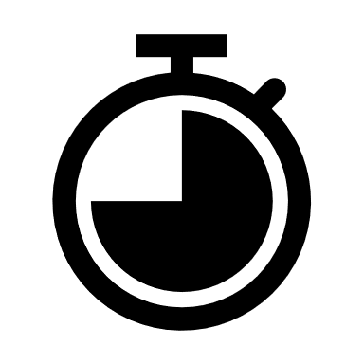

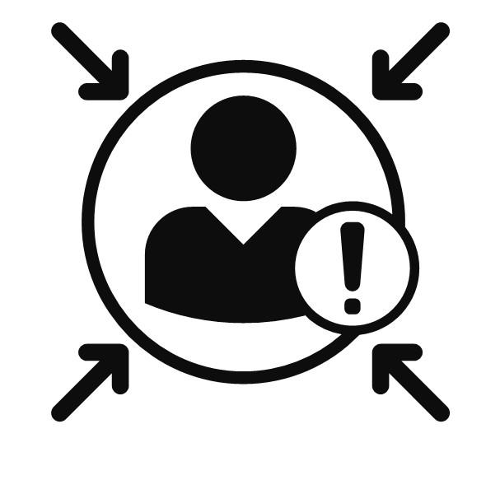

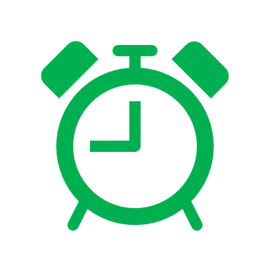
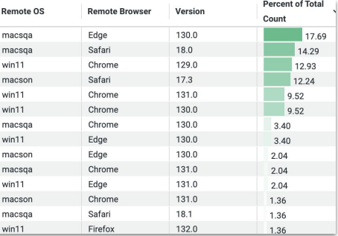
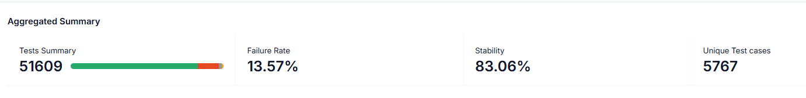
DIGITAL AUTOMATION
Boost Cross-Browser Testing with BrowserStack and 60% Faster Execution via DX1 Pipeline
PROBLEM STATEMENT
BROWSERSTACK BENEFITS
CHALLENGES/RISKS
Manual Execution Faces the Following Challenges :
Real Device Testing
Highly Dynamic Nature of web pages.
DX1 pipelines have a 2-hour execution time limit.
Application exhibits latency issues when evaluated in Browser Stack.
Legacy Selenium 3 automation scripts
Cross-Browser Compatibility testing
High time consumption
One Browser
Dashboards to check stability of Automation
Resource-intensive
Automation of pipelines using DXOne framework​
Scheduled on all browsers, including Edge, Chrome, and Firefox.
MOST FREQUENT BROWSER COMBIANTION OF TESTING
LAST RELEASE UAT AUTOMATION METRICS
LAST 30 DAYS AUTOMATION METRICS

Slide 2
Digital SelfService Portal Automation
Partial Automation to 100% automation for Digital SelfService Portal Applications
Baseline Assessment
There was some automation in place using Unified Automation framework, identified the following gaps during the baseline assessment
Sequential Execution & Manual driver updates
No Schedulers in Place, Triggering Manually
Hardcoded sensitive data in config files
Duplicate maintenance efforts due to lack of centralization of code & Lack of integrated compliance & Stage gate
No detailed and customizable test execution reports
Lack of Gitlab Pipeline integration
No in-sprint automation, which is causing delays in automation and increasing backlogs.
Outcome - Success
Parallel execution (50% reduction in execution time & Automated driver updates
Easy to maintain framework at one central location
DXOne conditional pipelines for CI/CD testing, compliance, binary scans, ready to use CI templates, improved stability, performance & security
Comprehensive view of test reports
With integration with Browserstack in once place to see and share Test reports.
Implemented in sprint automation, resulting in no backlogs. In higher environments, we are now able to complete testing faster with the help of automation.
2
2
2

